Slide 1


| DevOps and Cloud Computing
Advanced Bash Scripting

Slide 2

Objective
Manage and monitor background processes in Linux.
Automate system administration tasks using Bash scripts.
Perform file handling, string manipulation, and file compression with Bash commands.
Use command substitution and process substitution for efficient script execution.

Slide 3
Explaining foreground vs. background processes in Linux.

Slide 4
Foreground vs Background
In Linux, foreground processes require direct user interaction and tie up the terminal until they finish. Background processes, on the other hand, run independently, freeing up the terminal for other tasks.
Key differences:
1. Interaction:
Foreground processes connect to the terminal, allowing communication with the user via the screen and keyboard.
Background processes disconnect from the terminal and typically don't require user interaction.

Slide 5
Foreground vs Background
2. Execution:
By default, programs run as foreground processes.
To run a process in the background, add an ampersand (&) at the end of the command.
3. Management:
You can suspend a foreground process with Ctrl+Z and move it to the background using the bg command.
The jobs command lists background processes started from the current shell.

Slide 6
Foreground vs Background
4. Terminal Connection:
Background processes are not detached from your terminal. Closing the terminal may kill background jobs unless nohup is used.
5. Processing:
The processor schedules foreground and background processes in the same way. The main difference is whether the shell waits for the process to finish.

Slide 7
Demonstrating running commands in the background using ‘&’

Slide 8

Let’s do it
To run a command in the background in Linux, append an ampersand (&) to the end of the command. This tells the shell to execute the command as a separate background process, immediately freeing up the terminal.
For example:
This will start the vim text editor in the background. The terminal will display the shell job ID and the process ID (PID) of the background command.

Slide 9


Let’s do it
If the command produces output, it may interfere with the terminal prompt. To avoid this, redirect the output to a file or to /dev/null to discard it.
or

Slide 10
Monitoring background jobs using jobs and bring them back with fg or bg.

Slide 11


How to Monitor background jobs
To monitor background jobs in Linux, use the jobs command.
This command displays a list of all jobs running in the current shell, including their job number, state (running, stopped, or terminated), and the command that started them.
To bring a background job to the foreground, use the fg command followed by the job number.

Slide 12

How to Monitor background jobs
To resume a stopped job in the background, use the bg command followed by the job number.
For example, if jobs shows a job with the number 1, you would use fg %1 to bring it to the foreground or bg %1 to run it in the background.
The + and - symbols next to job numbers in the jobs output indicate the most recent and the previous jobs, respectively.

Slide 13
Quiz 1
Q. What information does the jobs command provide?
A
B
A list of all processes on the system.
The job number, state (running, stopped, or terminated), and the command that started the job

Slide 14
Quiz 1
Q. What information does the jobs command provide?
A
B
A list of all processes on the system.
The job number, state (running, stopped, or terminated), and the command that started the job

Slide 15
Quiz 1
Q. What does the command fg do without a job number?
A
B
It brings all background jobs to the foreground
It brings the most recent job to the foreground.

Slide 16
Quiz 1
Q. What does the command fg do without a job number?
A
B
It brings all background jobs to the foreground
It brings the most recent job to the foreground.

Slide 17
Common system administration tasks that can be automated

Slide 18
Let’s Discuss
System administrators can automate many routine tasks to improve efficiency and reduce errors. Common examples include:
Backup and Recovery
Patching
User Management
Log Management and Analysis
Server Provisioning
Password resets
Restarting services
Remote shutdowns

Slide 19
Demonstrating writing a bashscript for automating system updates or log rotation

Slide 20
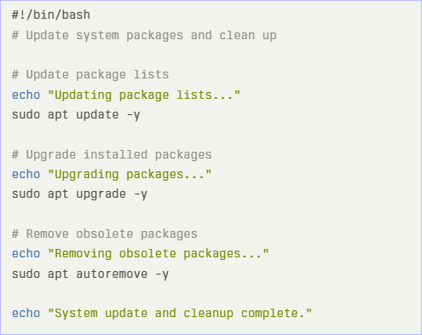
Let’s do it
1. System Update Script
This script automates updating and upgrading packages on Debian/Ubuntu-based systems. It also cleans up obsolete packages.

Slide 21
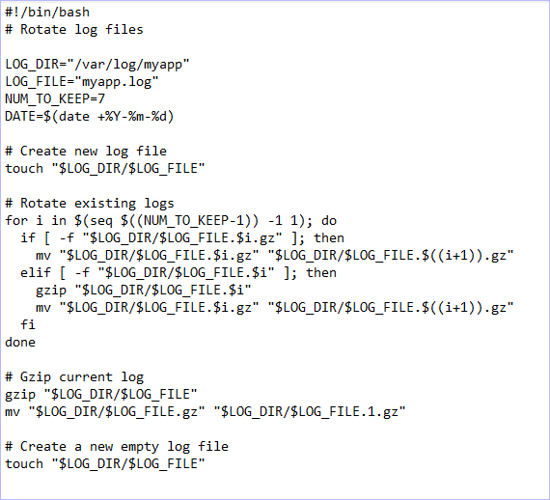
Let’s do it
2. Log Rotation Script
This script rotates log files, compressing the old ones and deleting the oldest.

Slide 22


Take A 5-Minute Break!
Stretch and relax
Hydrate
Clear your mind
Be back in 5 minutes

Slide 23
File Handling Commands

Slide 24



Let’s learn
1. Creating Files:
touch filename: Creates an empty file named "filename“
2. Reading Files:
cat filename: Displays the entire content of "filename" in the terminal
‘less filename’: Opens "filename" in a pager, allowing you to scroll through the content. Press ‘q’ to exit.

Slide 25

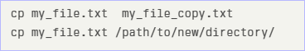
Let’s learn
3. Deleting Files:
‘rm filename’: Deletes the file "filename". Use with caution as this is permanent.
4. Copying Files:
‘cp source destination’: Copies the content of "source" file to "destination".

Slide 26


Let’s learn
5. Moving/Renaming Files:
‘mv oldname newname’: Renames the file from "oldname" to "newname".
‘mv source /path/to/destination/’: Moves the "source" file to the specified "destination" directory

Slide 27
String manipulation using
tools like awk, sed, and parameter expansion

Slide 28
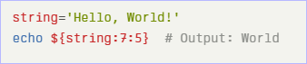
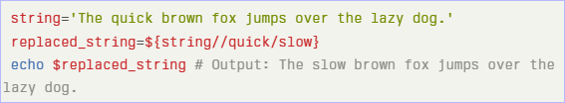
String Manipulation
Parameter Expansion (Bash Built-in):
Substring Extraction:
Pattern Replacement:

Slide 29
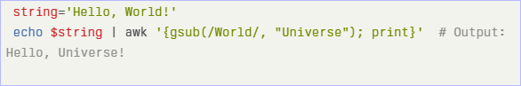
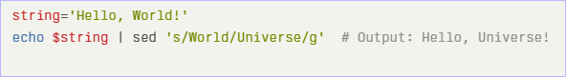
String Manipulation
2. awk:
awk is a powerful text processing tool that can be used to manipulate strings1. The gsub() function can be used for substitution.
3. sed (Stream Editor):
sed is another tool for string manipulation, often used for substitution.

Slide 30

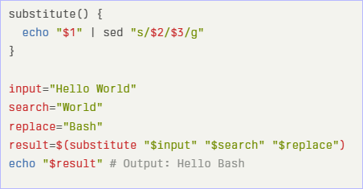
String Manipulation
You can modify files in place with the ‘-i’ flag.
Example Custom Functions (using ‘sed’):

Slide 31
Demonstrating file compression using gzip, bzip2, and tar for archiving

Slide 32



Let’s do it
Here's how to use gzip, bzip2, and tar for file compression and archiving:
Tar for Archiving:
To create a tar file, use the following command:
To view the contents of the archive:
To extract the archive:

Slide 33

Let’s do it
2. Compressing Archives with Gzip:
‘tar’ can use ‘gzip’ to compress archived files. The ‘-z’ switch makes the ‘tar’ command use ‘gzip’.
To create a Gzip compressed archive file.
To extract the contents of a Gzip compressed file.

Slide 34
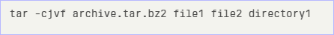

Let’s do it
3. Compressing Archives with Bzip2:
‘tar’ supports other compression systems like ‘bzip2’, which may offer better compression rates.
To create a ‘Bzip2’ compressed file:
To extract a Bzip2 compressed file:

Slide 35
Quiz 2
Q. What does the -z switch do when using the tar command?
A
B
Uses gzip to compress archived files
Creates a Bzip2 compressed archive file

Slide 36
Quiz 2
Q. What does the -z switch do when using the tar command?
A
B
Uses gzip to compress archived files
Creates a Bzip2 compressed archive file

Slide 37
Explaining command substitution using backticks (‘command’) and $()

Slide 38
Command substitution
Command substitution in Bash allows you to execute a command and insert its output into another command or context.
Backticks (‘command’):
Encloses the command to be executed.
The output of the command replaces the backtick expression.
Backticks are an older syntax and can be harder to read, especially with nested commands, because they require escaping inner backticks.
$() Syntax:
Encloses the command to be executed.
Considered more readable and less prone to errors, especially when nesting commands.
The $( ) syntax is generally preferred over backticks in modern Bash scripting.

Slide 39
Command substitution
For example, to capture the output of ‘ls | wc –l’ (which lists the number of files in the current directory) and embed it in an echo command, you can use either syntax.
Or

Slide 40
Demonstrating how to use command substitution

Slide 41
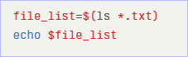
Let’s do it
You can perform command substitution using two primary methods:
‘$()’ Syntax: The recommended and more readable syntax.
Backticks (‘command’): An older syntax that is still functional but can be harder to read, especially when nesting commands.
Here are several examples demonstrating command substitution:
Assigning command output to a variable:

Slide 42

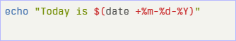
Let’s do it
Using command output as an argument:
Embedding command output in a string:

Slide 43
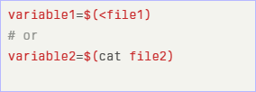
Let’s do it
Setting a variable to the contents of a file:
These commands set ‘variable1’ and ‘variable2’ to the contents of ‘file1’ and ‘file2’ respectively.

Slide 44
Introducing process substitution with <() and >().

Slide 45
Process substitution
Process substitution in Bash allows you to treat the output (or input) of a command as if it were a file. This is particularly useful for commands that expect file arguments but you want to use the output of another command directly.
Syntax:
<(command): Treats the output of command as a file for reading (input).
>(command): Treats the input as a file to be written to by command (output).

Slide 46
Process substitution
Example:
This command compares the output of two commands (‘ls *.c | cut -d. -f1’ and ‘ls *.out | cut -d. -f1’) as if they were files, without needing to create temporary files.

Slide 47
Providing Examples

Slide 48
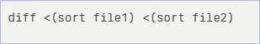


Examples
Examples:
1. Compare two files using ‘diff’ with process substitution:
2. Capturing the output of ‘ls’ and passing it as input to another command:
3. Comparing directory sizes:

Slide 49
Time for Case Study!

Slide 50
Important
Complete the post-class assessment
Complete assignments (if any)
Practice the concepts and techniques taught in this session
Review your lecture notes
Note down questions and queries regarding this session and consult the teaching assistant

Slide 51
Thanks!

